Slide 1
BREAK-EVEN ANALYSIS

Slide 2
INTRODUCTION
The signs of a healthy business include making a profit consistent with the various risks that it has to face.
A firm is faced with a number of uncertainties.
These uncertainties are created by the dynamic nature of consumer needs, the diverse nature of competition, the uncontrollable nature of most elements of cost, and the continuous technological developments.
So far as demand is concerned, save for the basic needs essential for survival, consumer preferences are highly subjective and, therefore, most unpredictable.

Slide 3
The nature of competition may be related to either product or price or to both simultaneously.
It is said that normally the degree of risk involved in product competition is greater than in price competition.
In period of continuously rising prices, no firm can be certain of its own internal cost structure.
Continuous technological developments may make today’s established commercial production completely obsolete in course of time.
However, if it does not have access to the improved process; it may have to go out of business altogether.

Slide 4
Unless a firm is prepared to face the uncertainties created by these risks, its profits would be left to chance.
Naturally, the firm will have to plan for profits.
In this respect, a through understanding of the relationship of cost, price and volume is extremely helpful to business executives.
The most important method of determining the cost-volume-profit relationship is that of break-even analysis.

Slide 5
Break-Even Point
The break-even analysis established a relationship between revenues and costs with respect to volume.
It indicates the level of sales at which costs and revenues are in equilibrium.
The equilibrium point is commonly known as the break-even point.

Slide 6
Definition
The break-even point may be defined as that level of sales at which total revenues equal total costs and the net income is equal to zero.
It is a no-profit, no-loss point. It should be noted, however, that the break-even point is just incidental in cost-volume-profit studies.
The main objective of the break-even point, but to develop an understanding of the relationships of cost, price and volume within a company’s practical range of operations.

Slide 7
Basic Assumptions
The behaviour of costs in predictable
The conventional cost-volume profit-model is based on the assumption that the costs of the firm are divisible into two components: fixed costs and variable costs.
Fixed costs remain unchanged for all ranges of output; variable costs very proportionately to volume. Hence the behaviour of costs is predictable.

Slide 8
2. The selling price per unit is constant
For firms which have a strong market for their products, this assumption is quite valid.
For other firms, however, it may not be so.
3. The firm manufactures a stable product-mix
In the case of a multi-product firm, the cost-volume-profit model assumes that the product-mix of the firm remains stable.

Slide 9
4. Inventory changes are nil
A final assumption underlying the conventional cost-volume-profit model is that the volume of sales is equal to the volume of production during an accounting period.
One of the important prerequisites for using the break-even analysis is that costs can be separated as fixed and variable.
Fixed costs arise as a result of capacity creation and are invariant with respect to variations of activity (Capacity utilization).
They may represent depreciation charges, property tax, insurance and rent which arise because the firm owns plant and equipment and hires factory premises; they may consist of salaries paid to managerial and supervisory staff; they may consist of interest burden on long-term debt.

Slide 10
Several important elements of cost vary directly with output. For example, the total material cost, the cost of power, labour charges and other utilities may vary directly with output are referred to as variable costs.
Break-even analysis may be carried out graphically or algebraically. We first deal with the graphical analysis and then with the algebraic

Slide 11
Graphical Analysis
[BEA is very commonly presented by means of break-even charts, also known as profit-charts]

Slide 12
60
55
50
45
40
35
30
25
20
15
10
5
0
SALES LINE
Profit Zone
COSTS AND REVENUE (RS. CRORES)
BREAK – EVEN POINT
Total Variable Costs
TOTAL COST LINE
FIXED COST LINE
LOSS ZONE
Total Fixed Costs
MARGIN OF SAFETY
5 10 15 20 25 30 35 40 45 50 55 60
BREAK-EVEN SALES (PHYSICAL UNITS) ‘000 UNITS
BREAK-EVEN PERCENTAGE OF CAPACITY

Slide 13
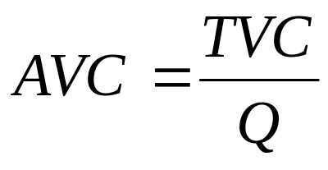
ALGEBRAIC ANALYSIS:
For algebraic analysis of break-even point, we may use the following symbols.
F = Total Fixed Cost
Q = Quantity Produced and Sold
V = Unit Variable Cost
(1)
TVC = Total Variable Costs = QXV
P = Unit Selling Price
TR = Total Revenue = QXP
Π = Profit
Π = QXP – QXV – F

Slide 14
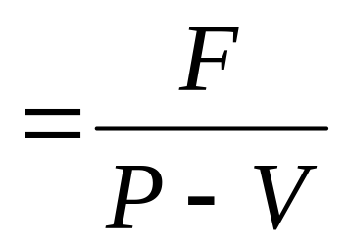
Break-Even Quantity
The break-even quantity is the value of quantity (Q) for which the profit (Π) is Zero. Setting Π equal to zero in e.g. (1) we get:
Break-even quantity (QB) (2)
In e.g. (2), (P-V), which represents the difference between unit selling price and unit variable cost, is called the contribution margin.

Slide 15
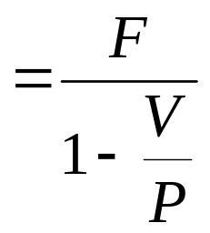
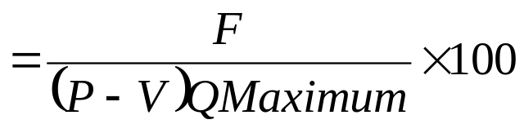
Break-even Sales in Rupees
It is simply break-even quantity X unit selling price. The following equation, derived from E.g.(2) can be employed to calculate more directly the break-even sales in rupees.
Break-even sales in Rupees (SB) (3)
Break-even Percentage of Capacity
Break-even point in terms of percentage of plant capacity can be expressed as;
Break-even percentage capacity (%B)
(4)

Slide 16
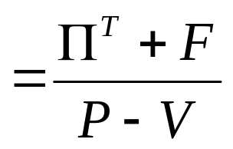
Profit for a given Quantity
The profit (Π) for a given quantity level is obtained by putting the value of quantity (Q) on the right-hand side of E.g. (1) i.e.,
Π = Q (P-V) – F (5)
Volume needed to attain Target Profit
Break-even analysis may be utilized for the purpose of determining the volume of sales necessary to achieve a target profit.
Target Sales Volume
where ΠT is target profit.

Slide 17
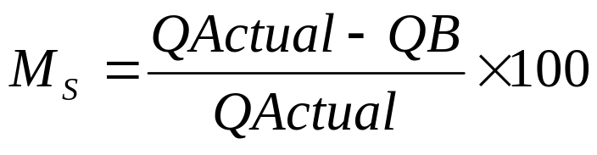
Margin of Safety
It is the excess of actual sales (or budgeted sales) over the break-even sales volume.
(7)

Slide 18
Problem Solving
A manufacturing unit undertakes the production of a certain commodity with
Selling Price per unit = Rs.20
Variable Cost per unit = Rs.12
Total Fixed Costs = Rs.5,60,000
What is the break-even output?
What is the break-even sales in rupees?
What is the profit earned when the output is 1,00,000 units.?
What should be the output to achieve a target profit of Rs.4,00,000?

Slide 19
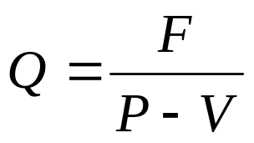
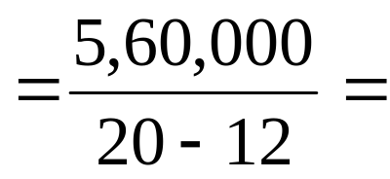
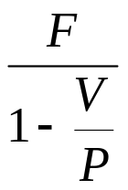
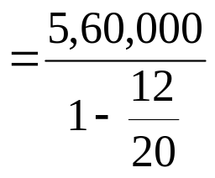
Solution
(a) The Break-even Output is
70,000 Units
(b) The Break-even sales in Rupees is
= Rs.14,00,000

Slide 20
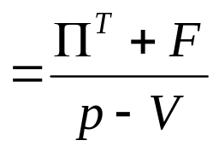
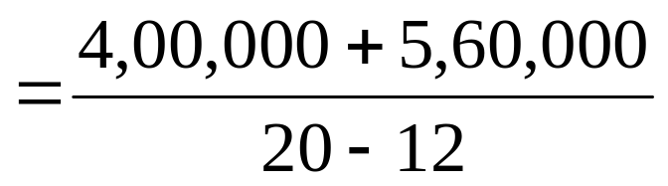
The Profit earned when the output is 1,00,000 units
Π = Q (P-V) – F
= 1,00,000 (20 – 12) 5,60,000
Π = Rs.2,40,000
The output required for achieving a target profit of Rs.4,00,000 is:
= 1,20,000 Units

Slide 21
Examples
A firm has purchased a plant to manufacture a new product, the cost data for which is given below:
Estimated Annual Sales : 24,000 units
Estimates Costs –
Material : Rs.4/- per unit
Direct Labour : Rs.0.60 per unit
Overhead : 24,000 per year
Administration Expenses : 28,800 per year
Selling Expenses : 15% of Sales
(i) Calculate the selling price, if profit per unit is Rs.1.02;
(ii) Find out the break-even point in terms of units of output.

Slide 22
Solution
(i) Estimated cost of production for 24,000 units –
Material at Rs.4 per unit : Rs.96,000/-
Direct Labour : Rs.14,400/-
Administrative Expenses : Rs.28,800/-
Overheads : Rs.24,000/-
----------------
Total Cost of Production : Rs.1,63,200/-
=========
TC = TCP + Total Selling Cost
= 1,63,200 + 15% of sales
Π on 24,000 units at Rs.1.02 = Rs.24,480/-
Let the sales volume = Rs. X
Then Rs. X = TC + Π

Slide 23
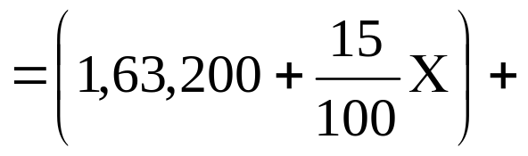
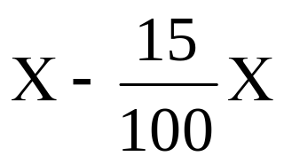
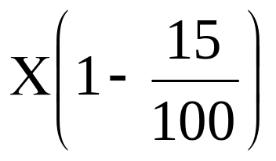
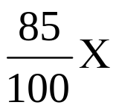
Rs.24,480
= 1,87,680
= Rs. 1,87,680
= 1,87,680

Slide 24
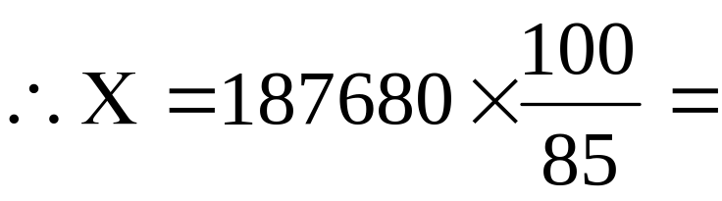
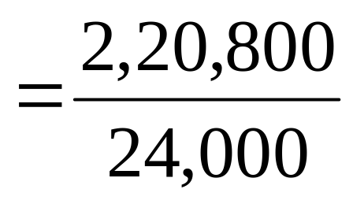
Rs. 2,20,800
The Values of Sales Volume = Rs.2,20,800
Value of Sales Volume
Selling Price = ------------------------------
Sales Volume

Slide 25
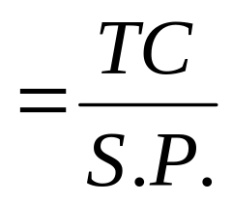
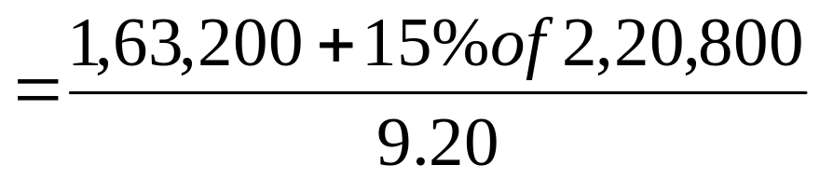
Selling Price = 9.20
(ii) AT BEP: TR – TC = 0
OR TR = TC
Units Sold X Selling Price = TC
Q BEP

Slide 26
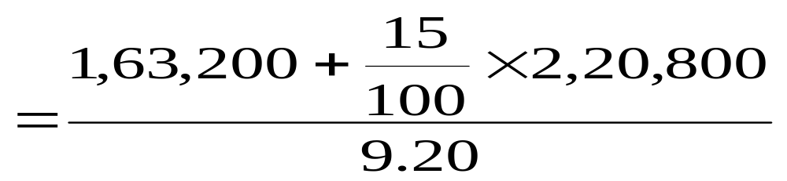
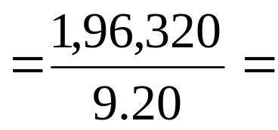
21,339.130 Units
OR QBEP = 21,340 Units

Slide 27
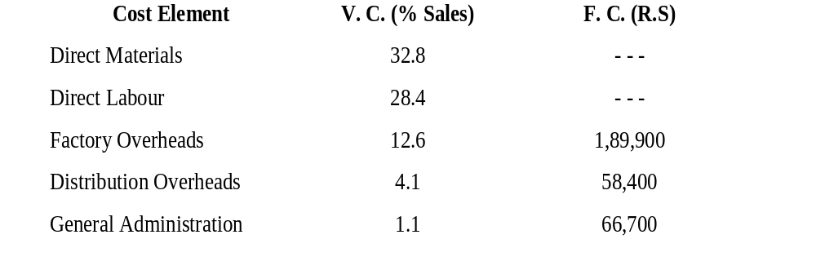
The following information is available for Sulthan Mfg. Co. Ltd.
Budgeted Sales are Rs.18,50,000. You are required to determine:
The BE Sales Volume.
The profit at the Budgeted Sales Volume.
The profit if actual sales drop by 10% and
increase by 5% from budgeted sales.

Slide 28
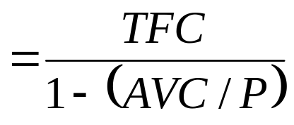
Solution:
(i) The BE Sales Volume:
In order to find the break-even point in terms of rupee volume of sales, we need to express the contribution margin as the fraction of price/ revenue that contributes to payments of fixed costs and profit:
Break-even Sales Volume

Slide 29
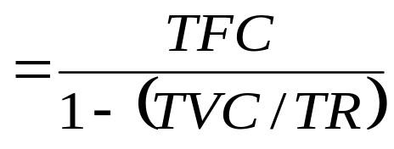
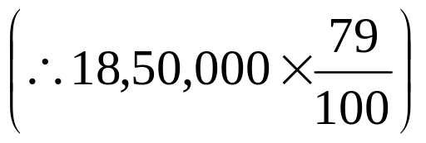
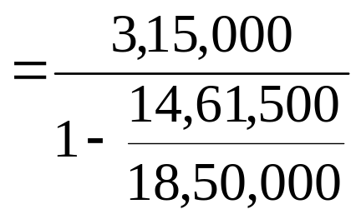
Break-even Sales Volume
Note: Both e.g.s. Yield the same result.
From the given information, TFC = Rs.3,15,000 and TVC is 79% of budgeted sales
i.e. = Rs.14,61,500
Substituting the values

Slide 30
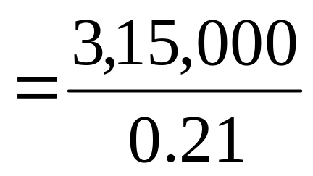
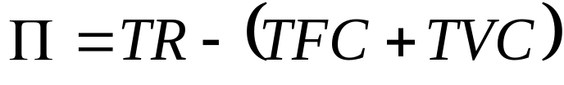

= Rs.15,00,000
(i) The Profit at the Budgeted Sales Volume:

Slide 31
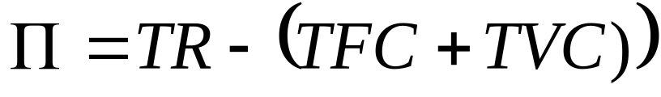
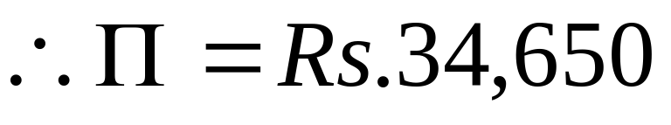
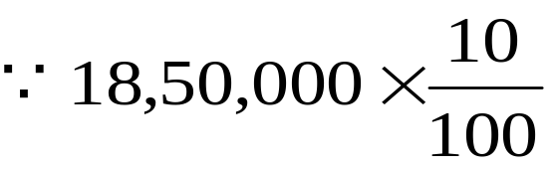
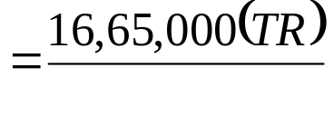
(ii)The Profit of Actual Sales Drop by 10%:

Slide 32
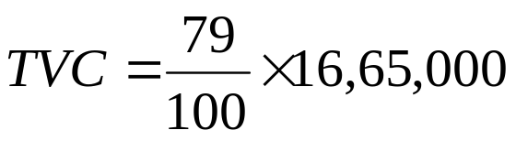
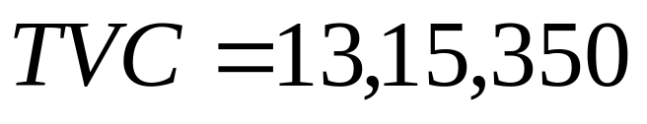
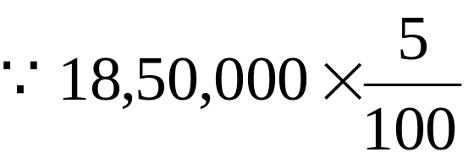
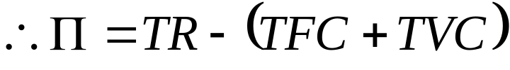
The profit if actual sales increase by 5% when actual sales increase by 5% budgeted ales will increase to Rs.19,42,500.
= 92,500

Slide 33
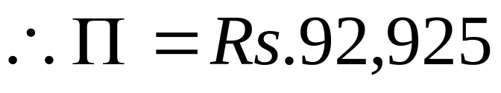
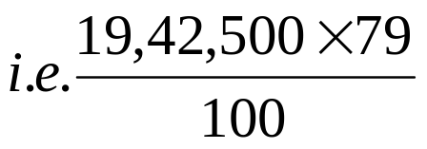
Then 18,50,000 + 92,500
= Rs.19,42,500
TVC = 79% of sales
= 15,34,575

Slide 34
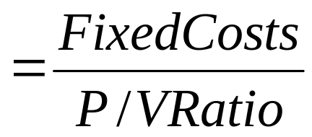

3. For a firm, total sales value is Rs.10,00,000 where total direct cost is Rs.6,70,000 and total fixed cost is Rs.2,30,000. Find the B.E. condition of the firm.
Solution: BEP (Rupees)
(Note that the contribution ratio is also known as P/V ratio)
where P → represents profit as an equivalent of contribution
and V → represents volume as an equivalent of sales.
Sales | Variable Costs | Contribution | P/V Ratio
Rs.10,00,000 | Rs.6,70,000 | 3,30,000

Slide 35
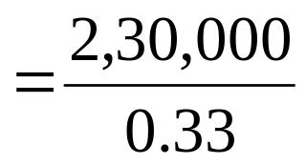
i.e. 33% BEP
= Rs.6,96,969.696
OR BEP = 6,96,970

Slide 36
4. From the following data you are required to calculate break-even point and net sales value at this point.
Direct Material Cost per unit : Rs.8
Direct Labour Cost per unit : Rs.5
Fixed Overheads : Rs.24,000
Variable Overhead @60% on direct labour:Rs.3/-
Selling Price per unit : Rs.25/-
Trade Discount : 4 per cent

Slide 37
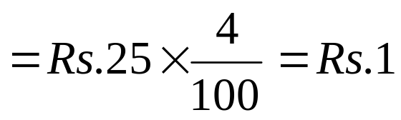
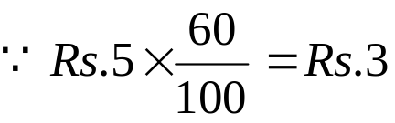
Solution:
Selling price Rs.25
Trade Discount 4%
Net realization per unit sold = Rs.25 – 1 = Rs.24/-.
V.C D.M.C. = Rs.8
D.L.C. = Rs.5
V. Overhead = Rs.3
----------------------------------
Total = Rs.16
=====================

Slide 38
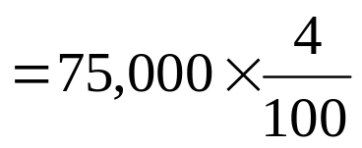

Contribution margin = SP – VC = Rs.24 – Rs.16 = Rs.8
FC 24,000
1) BEP Sales Units = ----------------- = ----------- = 3,000 units
C.M. per unit Rs.8
2) Net Sales Value at BE Sales Value = Units sold X S.P.
= 3,000 x Rs.25 = Rs.75,000
Net Sales Value at BE Sales Value = Units sold X S.P.
= 3,000 x Rs.25 = Rs.75,000
Trade Discount of 4%
=Rs.3,000
(75,000-3,000) i.e., Rs.72,000
Net Sale Value = Rs.72,000/-

Slide 39
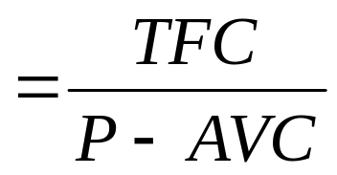
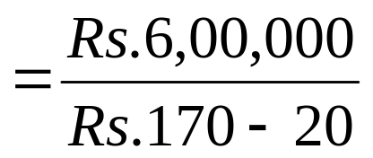
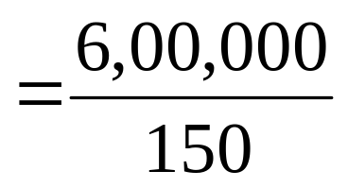
5. Deccan Airline has the monthly sealing capacity of 20,000 passengers on one of its routes at a fare of Rs.170/-. Variable cost is Rs.20 per passenger and fixed cost is Rs.6,00,000. Find
B E Quantity?
Solution:
Maximum number of passengers that can be carried on the route per month is 20,000. Fare is 170 per passenger, TFC is 6,00,000. V. C. per passenger is Rs.20.
TVC = 20,000 x 20 = Rs.4,00,000
(i) BEP (Quantity)
BEP = 4,000 passenger

Slide 40
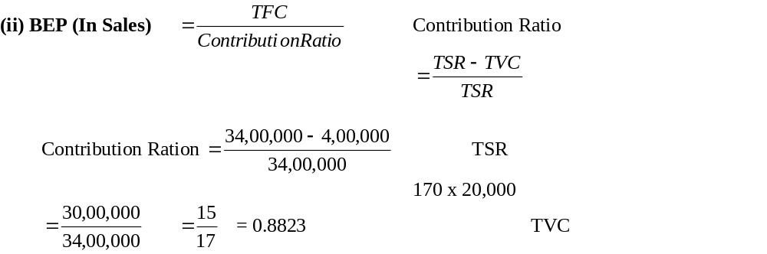
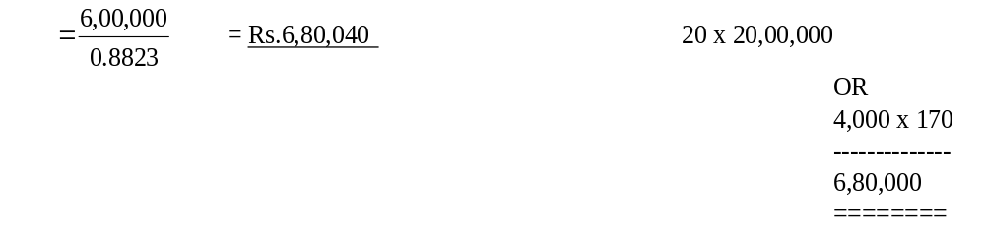

Slide 41
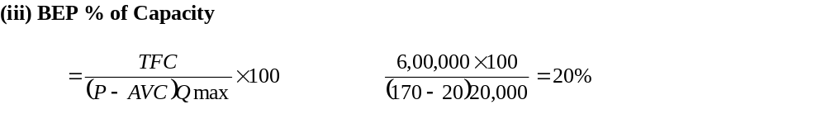


Slide 42



Slide 43


Slide 44




Slide 45



Slide 46



Slide 47



Slide 48


Slide 49



Slide 50



Slide 51



Slide 52



Slide 53


Slide 54

Conclusion:
Break-even analysis is a specific way of presenting and studying the inter-relationship between costs, volume and profits. It provides information to management in most lucid and precise manner. It is an effective and efficient financial reporting system.

Slide 55


Slide 56


Slide 57


Slide 58


